Slide 1
Pathogen – Fungi
Disease - Chytrid

Slide 2
Pathogen - Fungi

Slide 3
Fungi
As well as macroscopic fungi such as mushrooms and toadstools, fungi include microscopic forms – unicellular yeasts and moulds.
Fungi are eukaryotes and are usually larger than bacteria.
They reproduce using spores.
Fungi have a cell wall made of chitin.
As disease causing agents, fungal diseases are usually external, infecting and irritating the skin.
Examples of fungal diseases are tinea and ringworm, where spore-infected skin flakes off, spreading the infection.

Slide 4
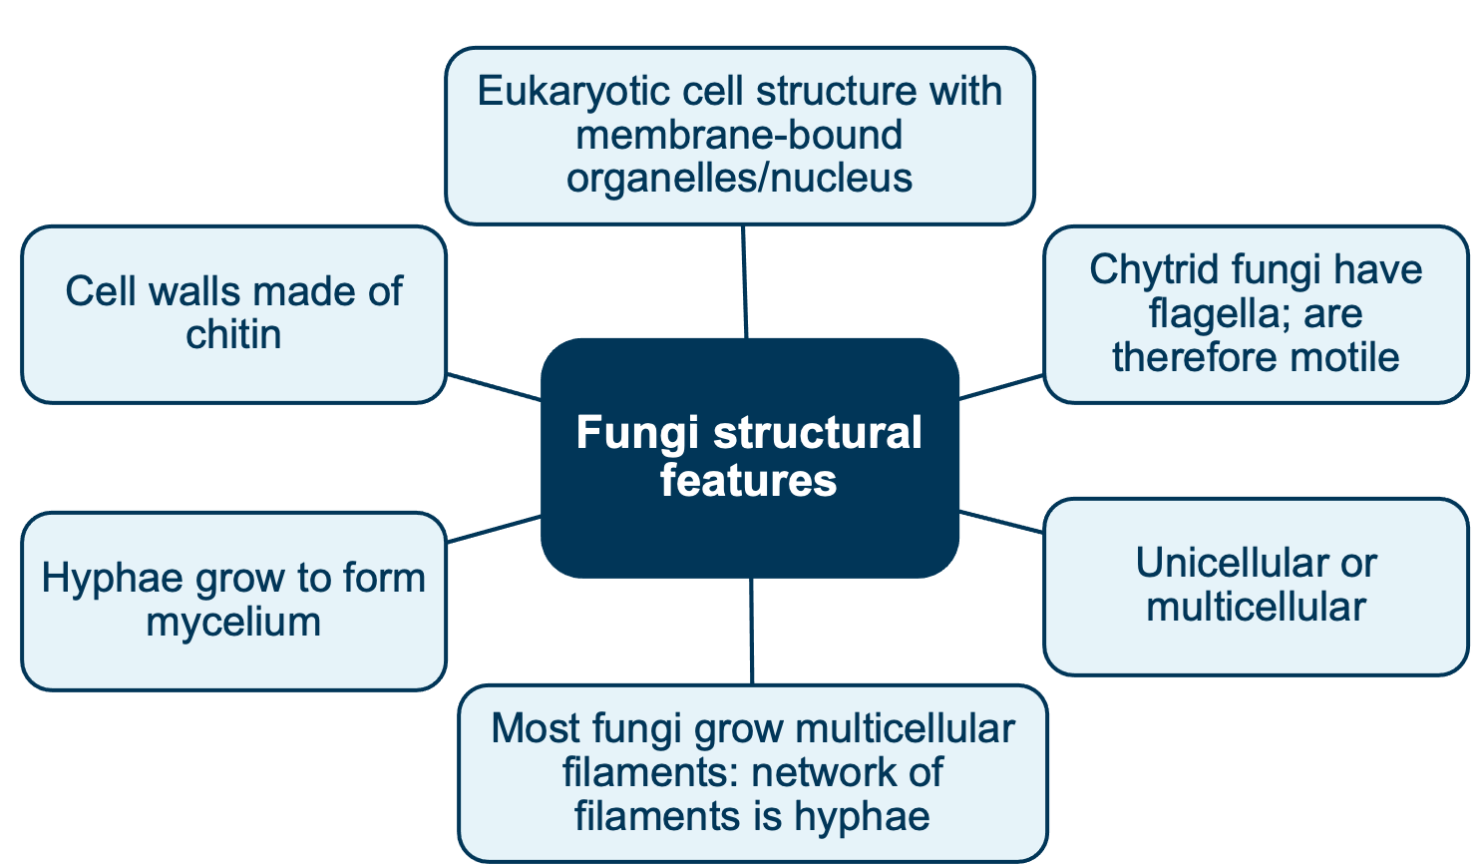
Fungi structural features
Can be microscopic or macroscopic

Slide 5
Fungi structural features
This diagram shows the basic structural features of fungi:
a optical microscope image of a mycelium film showing a branched network of microfilaments (hyphae) Mycelium is the network of threads, called hyphae, from which mushrooms grow. Not all mycelia fruit mushrooms, depending on the environmental conditions, but all mushrooms come from mycelia.
b schematic representation of a hypha composed of cells separated by cross walls (septa), all enclosed within a cell wall;
c schematic representation of the cell wall – a layer of chitin that surrounds the cell
membrane

Slide 6
Compare viruses, bacteria & fungi
Viruses | Bacteria | Fungi

Slide 7
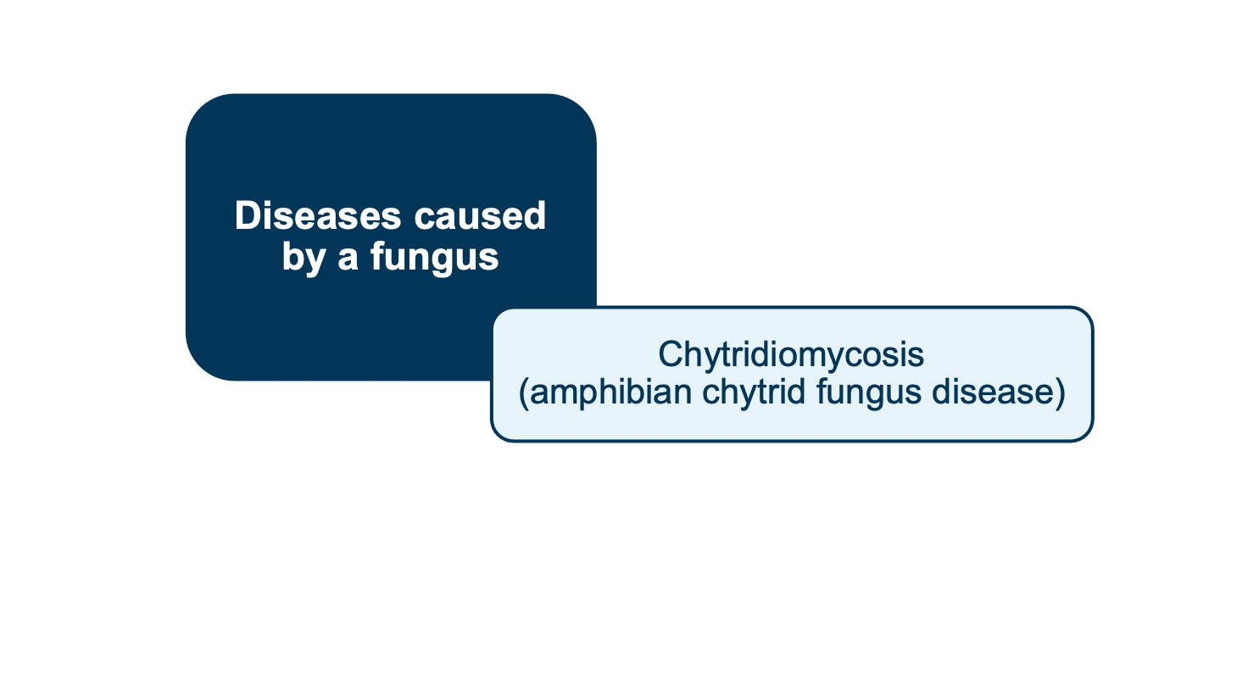
Examples of diseases caused by a fungus

Slide 8
Life Cycle - Fungi

Slide 9
Chytridiomycosis
The disease has been detected in all states of Australia and is affecting amphibians worldwide. In WA, the main area affected is the cooler south-west, possibly because the fungus is temperature sensitive.
The disease causes amphibians to die, and at times mortality in a population
is 100%.

Slide 10
Chytridiomycosis
Watch
https://www.youtube.com/watch?v=BvidpapF1bg

Slide 11
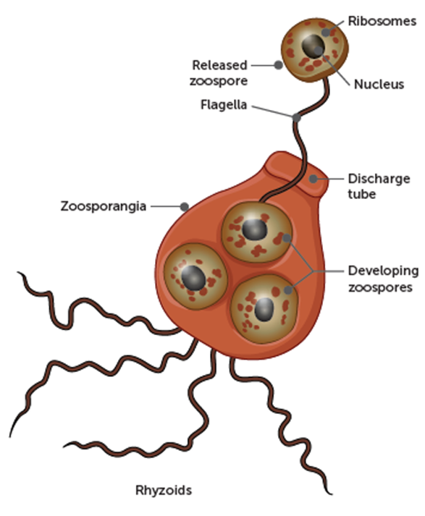
Chytridiomycosis Fungi Structure
The entire structure is called the Thallus
The disease chytridiomycosis is caused by the fungus Batrachochytrium dendrobatidis.
The chytrid fungus typically lives in water or soil and usually reproduces asexually.
Its zoospores have a single posterior flagellum, a whip-like tail, which provides the zoospore with locomotion (makes it motile and able to swim through the water).
A Zoospore is a motile asexual spore. It has a flagellum so it can move.
A Zoosporangium in which zoospores develop. (botany) A sporangium, or conceptacle containing or producing zoospores.
Notes:
Sporangium is an enclosure in which spores are formed. It can be composed of a single cell or can be multicellular.

Slide 12
Chytridiomycosis Fungi Ecology
Read the document https://www.awe.gov.au/sites/default/files/documents/c-disease_1.pdf and take notes on the following for amphibian chytrid fungus:
Lives/habitat
Reproduction
What class of organism can be infected and examples
Environmental conditions it prefers
Notes:
Sporangium is an enclosure in which spores are formed. It can be composed of a single cell or can be multicellular.

Slide 13
Life Cycle of Batrachohytrium dendrobatidis (the ‘chytrid fungus’)
Complete notes while watching the following video:
https://www.youtube.com/watch?v=0tuxtewT2gU

Slide 15
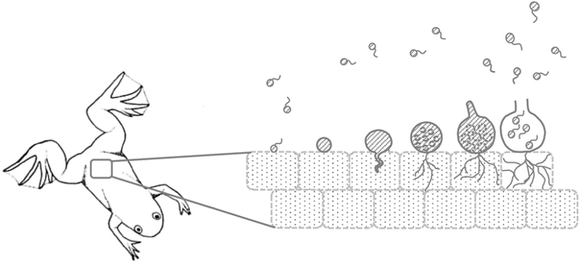
Chytridiomycosis life cycle

Slide 16
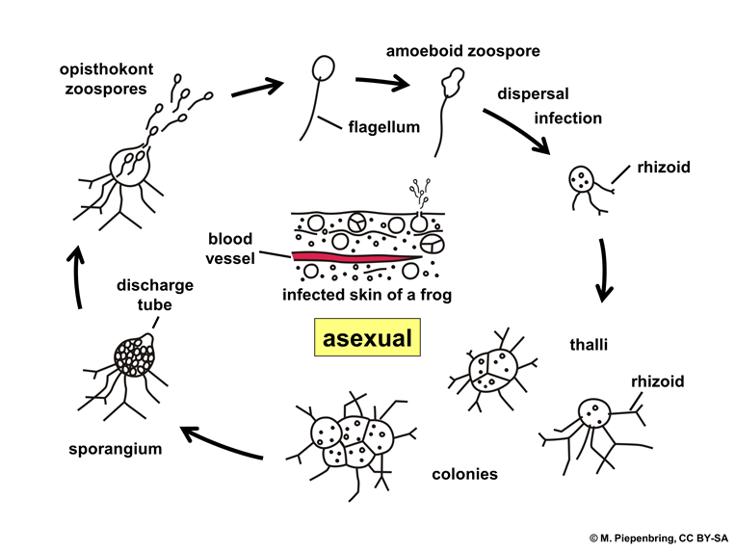

Slide 17
Chytridiomycosis Mode of Transmission
Indirect transmission through contact with water contaminated with zoospores – this is the most common (waterborne)
Direct contact between infected frogs and non-infected, susceptible frogs
Humans/animals (such as ducks) may spread it from one water body to another over land
However, transmission outside of water is not well known

Slide 18
Chytridiomycosis
Some amphibians are not seriously affect by the fungus however they may carry the pathogen so that it infects other species, some of which can be very seriously affected
Zoospores move out of the zoosporangium & either infect another part of the same host amphibian’s skin or move a short distance in the water by means of a single flagellum to another uninfected host

Slide 19
Impact on host
Read https://www.awe.gov.au/sites/default/files/documents/c-disease_1.pdf and take notes on how the amphibian chytrid fungus affects amphibian skin

Slide 20
Impact on host
Affects the part of the frog’s skin that has keratin
  The amphibian’s skin sheds
  The amphibian’s skin gets thickened and hardens
  Disrupts the normal functioning of the skin cells
  Respiration becomes difficult because significant gas exchange usually occurs across the moist skin under normal conditions.
  Frogs also use skin to exchange water & salts and this can become difficult when the skin thickens/hardens leading to osmotic problems
Affects the frogs nervous system
  The amphibian can become lethargic, sluggish, no appetite
  Hind legs extend
  These symptoms can lead to death.

Slide 21
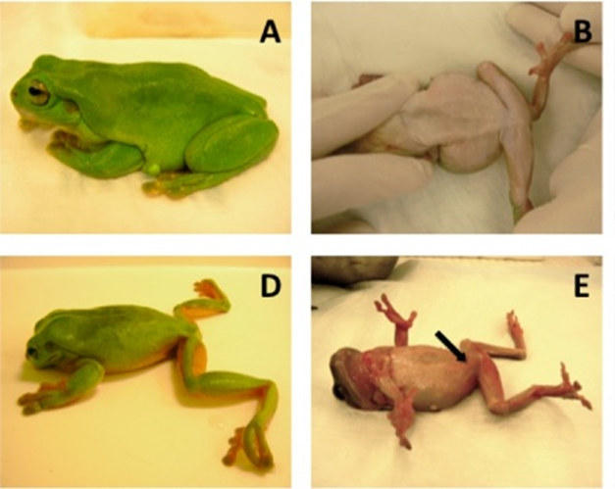

Slide 22
Control of Chytridiomycosis – read the resources below
http://www.environment.gov.au/system/files/resources/279bf387-09e0-433f-8973-3e18158febb6/files/c-disease_1.pdf
https://www.awe.gov.au/sites/default/files/documents/c-disease_1.pdf
https://www.awe.gov.au/sites/default/files/documents/tap-chytrid-fungus-2016.pdf

Slide 23
Control
Efforts should be aimed at protecting uninfected areas – Quarantine
Detect new outbreaks
Identify infected & non-infected areas
Establish restricted areas & control areas for which quarantines & movement restrictions are applied
Identify & prioritise Australian frog species at risk of extinction
Monitor impacts on frogs
Hygiene
Implement hygiene protocols for bushwalking, fishing, four-wheel driving & bike-riding. Disinfecting bikes, boots, vehicles & fishing equipment can prevent spread into uninfected areas

Slide 24
Climate change & Chytrid
Temperature sensitive fungus
It is currently confined to relatively cool, wet areas
https://www.bbc.com/news/science-environment-19199197
Is the Frog-Killing Chytrid Fungus Fueled by Climate Fluctuations? - Scientific American
https://www.awe.gov.au/sites/default/files/documents/tap-chytrid-fungus-2016.pdf

Slide 25
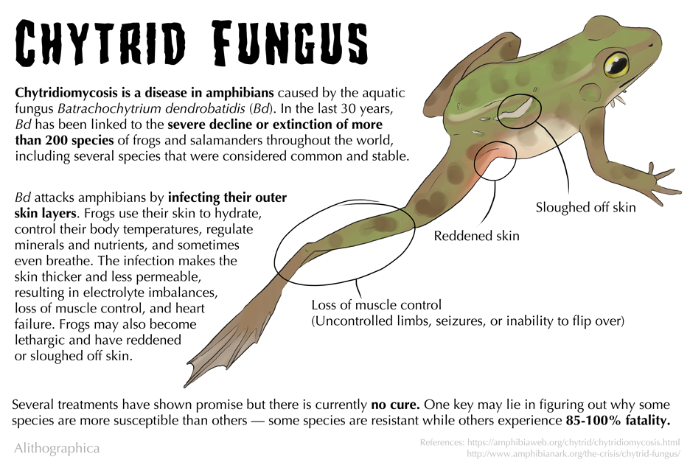

Slide 26

Life Cycle
Zoospores are released in water.
The Zoospores are produced and released from a mature zoosporangium (or thallus) discharge tube.
Zoospores ‘swim’ a short distance or are carried by water currents.
A new thallus develops discharge tubes that grow toward the skin surface
The thallus matures into a zoosporangium and zoospores are produced via asexual reproduction - mitotic division
Zoospores encounter a new susceptible host and attach to and penetrate a skin cell. This is the portal of entry.
When zoospores come into contact with the skin of an amphibian, they penetrate the skin & use the skin as a food source.
The growth of the Thallus on the amphibian’s skin, damaging the skin
The damage Chytridiomycosis causes damages the frog’s skin causing reduced respiration & osmoregulation, leading to death
Notes:
Life cycle is asexual

